Slide 1


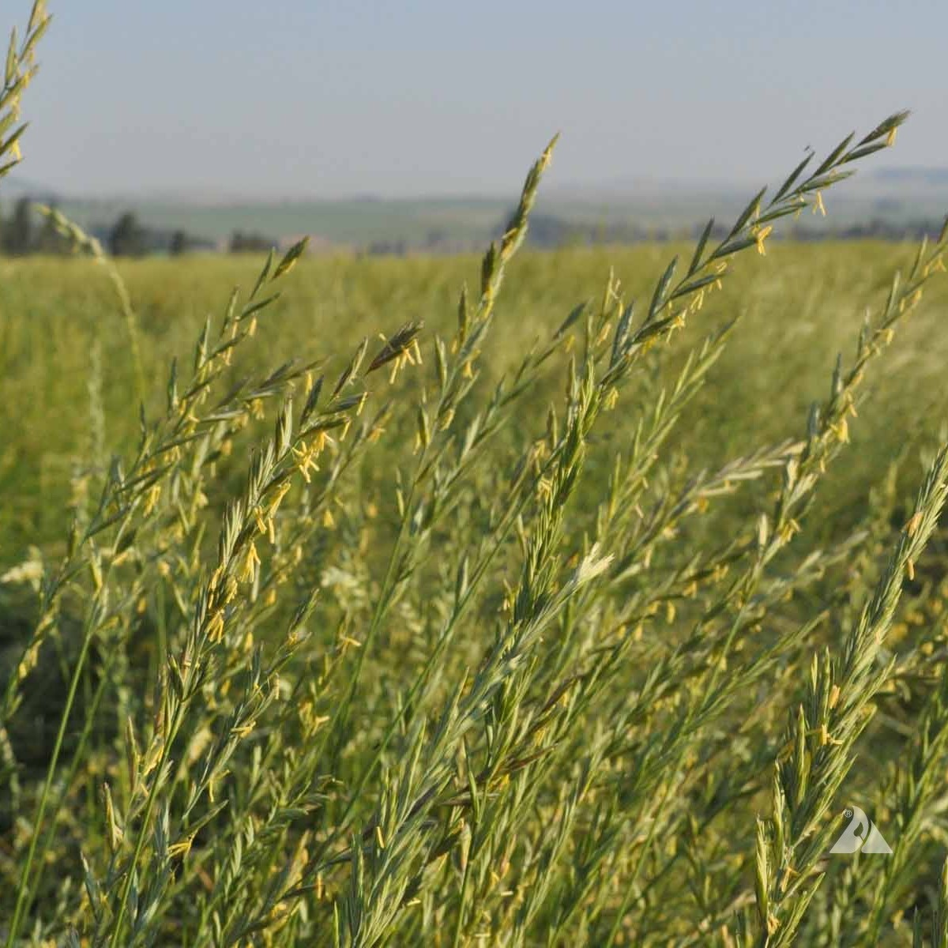
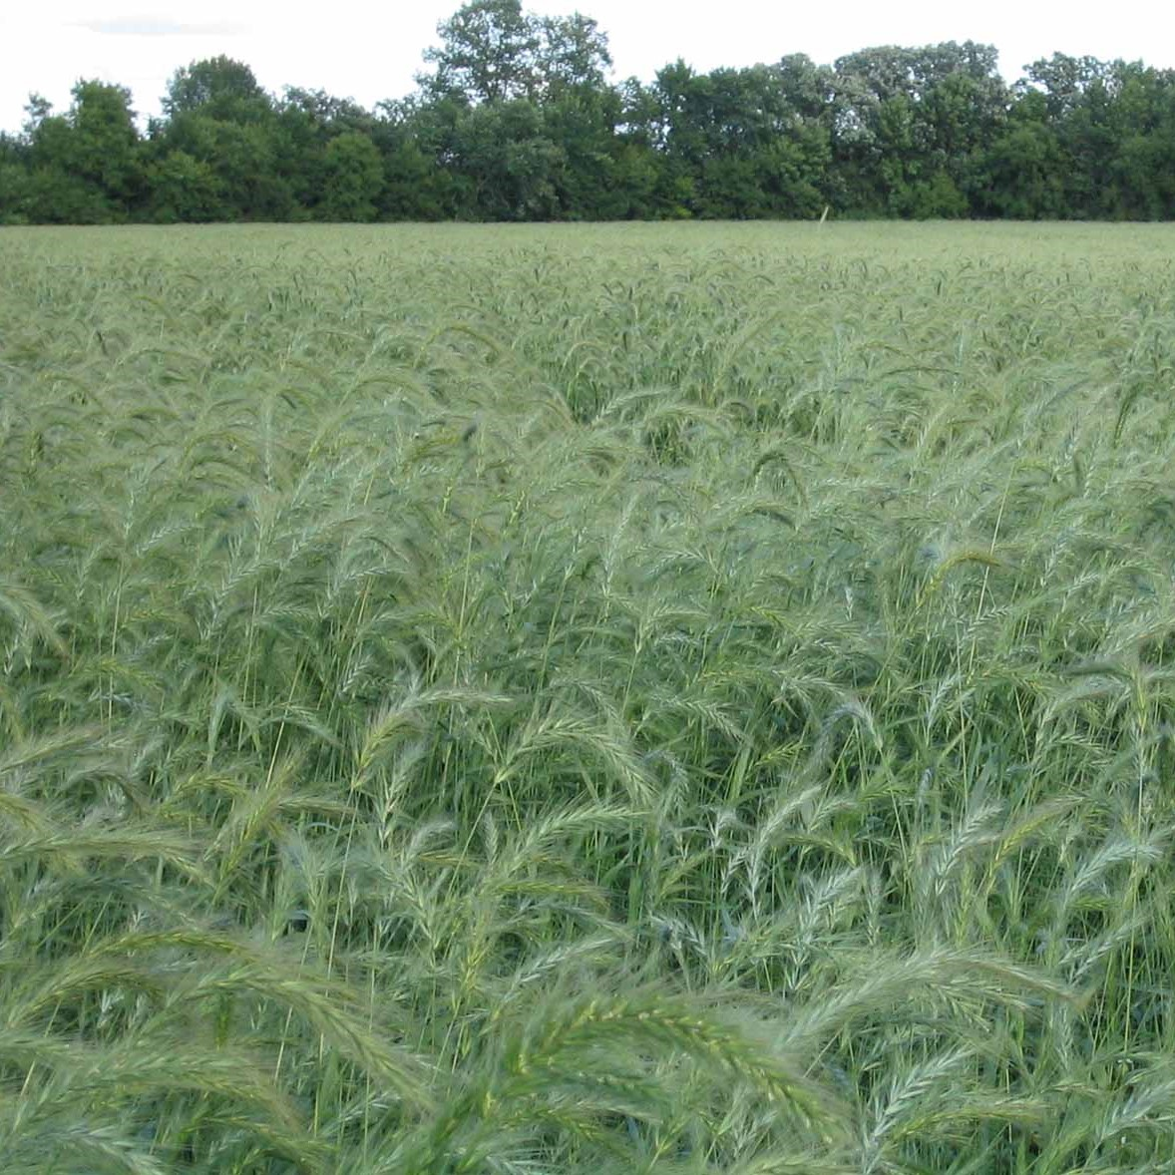
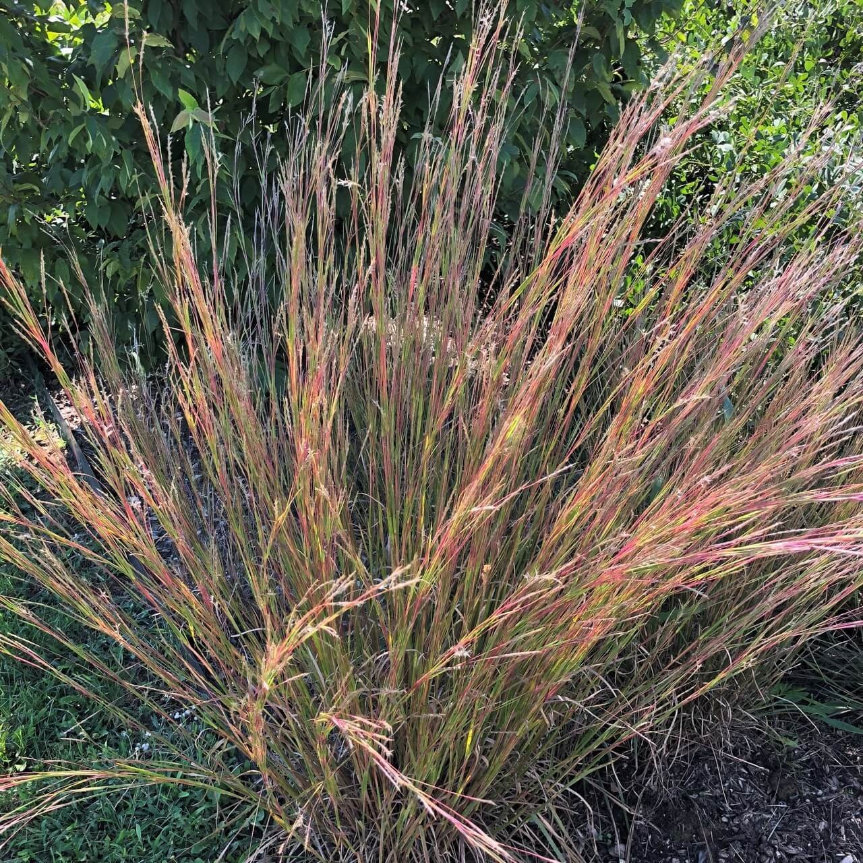
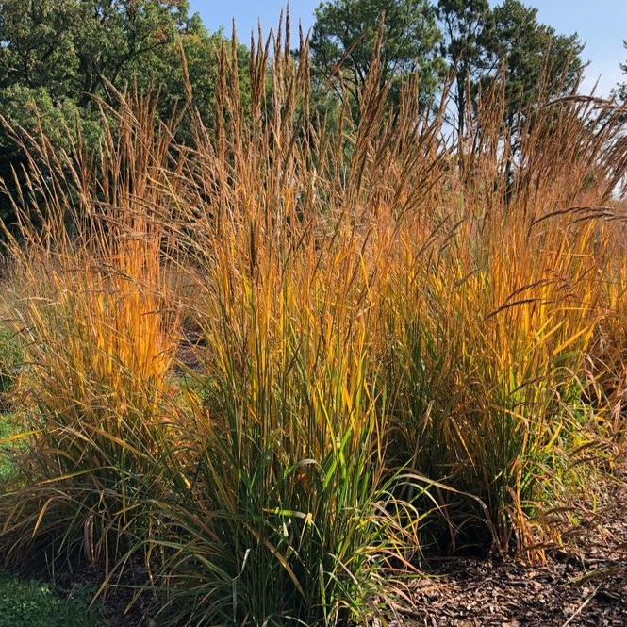

Temperature response of photosystem II quantum efficiency in C₃ versus C₄ grasses
How do the different types of Photosynthesis respond to rising temperature?
Garrison Garza¹, Nicholas G. Smith¹
¹Department of Biological Sciences, Texas Tech University, Lubbock TX
INTRODUCTION
ANALYSIS
Global temperatures are rising from excessive CO₂ emissions
Terrestrial photosynthesis offsets 30% of human CO₂ emissions
Chlorophyll Fluorescence can measure Photosynthetic Efficiency (𝚽PSII)
What are the differences in temperature responses of 𝚽PSII between C₃ and C₄ photosynthesis in different species of grasses?
3 Hypothesis:
Temperature Optimum of C₄ > C₃
Optimal Temperature Range of C₄ > C₃
𝚽PSII at T-Opt of C₄ < C₃
Analysis performed in R Studio
Temperature Response curves fitted for each plant
Data from individual curves were pulled to fit overall photosynthetic pathway curves
C₃:
C₄:
METHODS
DISCUSSION
Experimental Design
40 Plants grown over 12 weeks
4 Species, 2 C₃ and 2 C₄
5 Blocks, 2 Species per block
Measurements made using LiCOR-6800
Hypothesis 1: TRUE
Temperature Optimum of C₄ is significantly higher than C₃
P-value < 0.001
Hypothesis 2: TRUE
Breadth of C₄ Temperature Response curve is significantly higher than C₃
P-value < 0.001
Hypothesis 3: FALSE
𝚽PSII at Temperature Optimum of C₄ is significantly lower than C₃
P-value < 0.001
Hypothesis 1: Top Left
Hypothesis 2: Top Right
Hypothesis 3: Bottom Left
P. smithii (C₃₎
E. canadensis (C₃)
CONTACT ME
S. scoparium (C₄)
S. nutans (C₄)
garrgarz@ttu.edu

